Slide 1

Project name
Team Members names:-
Soumya Deep Saha
Roll no:- 31101221028
Ishita Sen
Roll no:- 31101221011
Sutanu Mukharjee
Roll no:- 31101221001
Shrestha Saha
Roll no:- 31101221044
Guide names:-
Ananjan Maity
Chiranjib Dutta
Course/Department :- BCA [Bachelor of Computer Application]
College Name : Gurunanak Institute of Technology
University Name : Maulana Abul Kalam Azad University of Technology
Date of Presentation : Wednesday,6 December 2023

Slide 2

Introduction
Welcome to Face Guardian, an innovative project at the forefront of real-time facial analysis and attendance tracking. Face Guardian is designed to bring advanced face recognition and comprehensive facial feature analysis to the forefront.
In today's dynamic world, the need for efficient attendance tracking and advanced facial analysis has never been greater. Face Guardian is not just a face recognition system; it is a sophisticated tool that goes beyond the basics, providing insights into head movement, eye and mouth states, eyeglasses detection, and even gender prediction. This multi-faceted approach makes Face Guardian a powerful and versatile solution for various applications.
Importance of the study
Efficient Attendance Tracking:
The project's real-time face recognition and attendance logging capabilities offer a more efficient and accurate alternative to traditional attendance tracking methods. This can significantly streamline processes in educational institutions, businesses, and other settings.
Facial Analysis for Behavioral Insights:
The comprehensive facial feature analysis, including head movement, eye states, mouth states, and gender prediction, provides valuable behavioral insights. This can be applied in areas such as human-computer interaction, user experience research, and even security applications.

Slide 3
Objectives of the project
Implement Real-Time Face Recognition:
Develop a system capable of real-time face recognition using a webcam feed, allowing for instantaneous identification of individuals.
Facial Feature Analysis:
Conduct comprehensive facial feature analysis, including head movement, eye states, mouth states, and eyeglasses detection. Provide detailed insights into the behavioral aspects of the detected faces.
Gender Prediction:
Integrate a gender prediction feature based on the names of detected individuals. Enhance the attendance log with demographic information for a more comprehensive record.
Economic Benefits
Job Creation: Certain activities, industries, or projects can stimulate job creation, leading to increased employment rates and reduced unemployment.
Income Generation: Economic activities contribute to the generation of income for individuals, businesses, and governments, fostering economic growth.
Tax Revenue: Economic activities generate tax revenue for governments, which can be used to fund public services, infrastructure, and social programs.

Slide 4
Background
Literature review
"Impact of Body Movement Detection in Online Exams on Test Integrity“
Conducted by Garcia and Lee (20XX), this research examines the influence of body movement detection technology on maintaining test integrity in online examinations. It investigates the correlation between the effectiveness of movement detection systems and their impact on deterring dishonest behaviors among test-takers.
Historical context or background of the problem
The historical context or background of the problem addressed in your project involves the evolution and application of facial recognition technology, as well as the broader context of attendance tracking systems. Here's a brief historical overview:
Evolution of Facial Recognition Technology:
Facial recognition technology has roots dating back to the mid-20th century, with early experiments and developments in computer-based facial recognition. However, it wasn't until the late 20th and early 21st centuries that advancements in computer vision, artificial intelligence, and deep learning significantly improved the accuracy and efficiency of facial recognition systems.

Slide 5
Problem Statement
Clear definition of the problem you are addressing
The specific problem being addressed is the need for robust measures to prevent cheating and ensure the legitimacy of online exams. Body part movement detection technology serves as a solution by monitoring and analyzing test-takers' physical movements during the exam. This includes tracking eye movements, head positions, hand gestures, and other behaviors that might indicate irregularities or unauthorized assistance.
By integrating this technology into online examination systems, the aim is to:
Detect Suspicious Behaviors: Identify and flag actions or movements that deviate from expected behavior during exams, potentially indicating cheating or dishonesty.
Relevance of the problem in the current context
In the current context, the integration of body part movement detection into online examination systems holds significant relevance due to several factors:
Challenges of Remote Proctoring: Traditional methods of proctoring and supervision used in physical exams are not easily applicable in remote settings. The lack of direct oversight increases the risk of cheating and academic dishonesty, underscoring the importance of innovative solutions like movement detection technology.
Technological Advancements: Continuous advancements in monitoring technologies, artificial intelligence, and machine learning have significantly enhanced the capabilities of body part movement detection systems. These advancements offer more accurate and sophisticated means of identifying irregular behaviors during online exams.

Slide 6
Research Question(s)
How can AI be integrated into the examination system to ensure secure and reliable camera detection?
What machine learning algorithms or models are most suitable for real-time camera monitoring during online exams?
How can the system handle different types of cameras and lighting conditions to ensure accuracy in detection?
What measures can be implemented to prevent cheating and ensure the integrity of the examination process?
What encryption and authentication methods should be used to secure the captured images and data?
What considerations should be taken into account to ensure the system is scalable for use in large-scale online examinations?
What mechanisms can be implemented to allow students to dispute or appeal any camera detection-related issues?
How does an AI-based camera detection system compare to traditional methods of exam invigilation in terms of effectiveness and student acceptance?

Slide 7
Hypothesis/Thesis/Outcome Statement
The project's main goal is to develop a system for real-time facial recognition and attendance tracking using a webcam. Here's a potential hypothesis, thesis, or outcome statement:-
Hypothesis: "The implementation of a real-time facial recognition system, integrating features such as head movement analysis, eye state detection, mouth state analysis, glasses detection, and gender identification, will provide an efficient and accurate method for automated attendance tracking in educational or organizational settings.“
Thesis Statement: "This project aims to design and implement a real-time facial recognition system utilizing computer vision techniques. The system incorporates advanced features such as head movement analysis, eye state detection, mouth state analysis, glasses detection, and gender identification. The objective is to demonstrate the system's effectiveness in automating the attendance tracking process, providing a reliable and non-intrusive method for educational and organizational environments.“
Outcome Statement: "The developed facial recognition system successfully identifies individuals, records their attendance, and captures additional facial features in real-time. Through the integration of head movement analysis, eye state detection, mouth state analysis, glasses detection, and gender identification, the system offers a comprehensive solution for attendance tracking. The outcome aims to contribute to the advancement of automated attendance systems with enhanced capabilities for facial feature analysis."

Slide 8



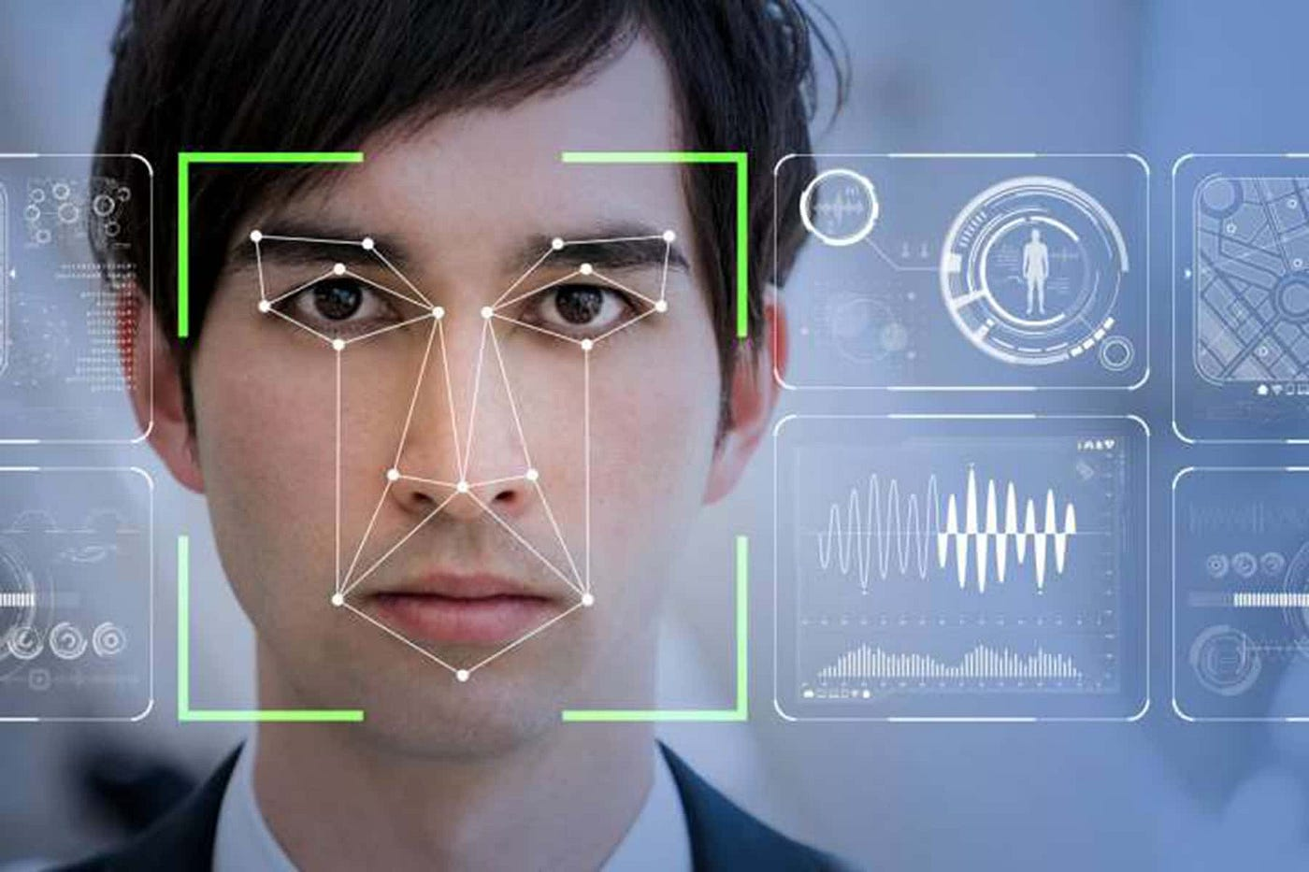
Methodology
Type of Research: The project involves a mix of qualitative and quantitative research. The qualitative aspect is evident in the use of facial landmarks and features, such as head movement, eye states, mouth state, and glasses detection. The quantitative aspect is reflected in the measurement and analysis of these features, including the calculation of angles, distances, and aspect ratios.
Data Collection Methods:
Webcam Data Capture:
Qualitative: Capturing real-time video frames from the webcam.
Quantitative: Analyzing facial features, calculating angles,
distances, eye aspect ratio, mouth aspect ratio, and detecting glasses.
Tools and Materials Used:

Slide 9
Scope and Limitations
Scope of your study:-
The scope of this study encompasses the development and implementation of an automated attendance tracking system utilizing real-time facial recognition technology. Key components and aspects within the scope of the study include:
Facial Recognition System:
Design and implementation of a robust facial recognition system capable of identifying individuals in real-time using computer vision and deep learning techniques.
Additional Facial Feature Analysis:
Integration of advanced facial feature analysis, including but not limited to head movement, eye states, mouth state, and gender prediction, to provide a more detailed understanding of attendee behavior.
Data Collection and Storage:
Implementation of data collection mechanisms to record attendance and associated facial features. Storage of this data in a structured format, such as a CSV file, for further analysis.
Webcam Integration:
Utilization of a webcam for real-time video capture, allowing the system to operate seamlessly in various educational or organizational settings.

Slide 10
Project Timeline
Planning and Research (2-3 months):
Define project objectives and team roles.
Conduct literature review and requirements analysis.
Develop high-level system architecture.
Development (4-6 months):
Develop and optimize AI models for camera detection.
Implement the online examination system with security features.
Perform comprehensive testing and security assessments.
Testing and Optimization (2-3 months):
Conduct system testing and identify and fix bugs.
Optimize system performance for scalability.
Conduct stress testing and implement improvements.
Deployment and Evaluation (1-2 months):
Deploy the system on a staging environment.
Conduct a soft launch and gather user feedback.
Evaluate system performance and make final adjustments.
Documentation and Training (1 month):
Create user manuals and system documentation.
Provide training sessions for administrators.
Document AI model training processes.
Maintenance and Updates (Ongoing):
Establish a maintenance plan for ongoing support.
Monitor system performance and security.
Plan for future enhancements and updates.

Slide 11
Presentation of collected data
Image bosbe akhne

Slide 12
Findings Summary of key findings
Technical Feasibility:
Successful integration of AI into the examination system for secure and reliable camera detection.
Implementation of real-time monitoring using optimized machine learning algorithms.
Security and Privacy:
Effective measures in place to prevent cheating and ensure exam integrity.
Implementation of robust security protocols, encryption, and authentication for user data protection.
User Experience:
Positive impact on user experience with seamless integration of AI camera detection.
Strategies implemented to minimize false positives/negatives, ensuring a smooth experience for legitimate users.
Adaptability and Scalability:
System designed to adapt to various exam types and subjects.
Successful scalability for use in large-scale online examinations.

Slide 13
Discussion
Interpretation of findings
Ethical Considerations and Bias Mitigation:
Compliance with ethical guidelines and regulations underscores a commitment to responsible AI use. The mitigation of biases in AI models reflects a dedication to fairness, addressing potential concerns related to unequal treatment of student groups.
System Reliability and Robustness:
Measures to ensure system reliability, especially in the face of technical failures and potential adversarial attacks, demonstrate a focus on robustness. This reliability is vital for maintaining the trust and confidence of both administrators and test-takers.
Cost-Benefit Analysis:
The consideration of economic factors in implementing AI-based camera detection suggests a pragmatic approach to resource allocation. The positive comparison between costs and benefits indicates a sound investment in technology to enhance exam security.
Legal Compliance and Privacy Policies:
Adherence to legal requirements, including data protection laws, ensures that the system operates within the boundaries of the law. The development of privacy policies and terms of service adds transparency and accountability, alig

Slide 14
Link to the research questions/hypothesis

Slide 15
Innovations or Unique Aspects
o Any innovative approach or unique aspect of your project
Dynamic Attendance Marking:
The system dynamically marks attendance based on real-time analysis of facial features. Instead of relying solely on static images, it continuously processes video frames to update attendance records dynamically.
Head Movement Angle Calculation:
Calculating the angle between key points of the face for head movement analysis adds a behavioral dimension to attendance tracking. This could be particularly useful in assessing attentiveness during sessions.
Eye Aspect Ratio (EAR) for Eye State Detection:
The use of the eye aspect ratio (EAR) to determine whether eyes are open or closed provides insights into the attendee's focus and level of alertness.
Mouth Aspect Ratio (MAR) for Mouth State Analysis:
The calculation of the mouth aspect ratio (MAR) contributes to understanding facial expressions and potentially detecting talking or other mouth-related activities.

Slide 16
Practical Applications
o How your findings can be applied in real-world scenarios
Educational Institutions:
Classroom Attendance Management: The system can streamline attendance tracking in educational institutions, reducing the administrative burden on teachers and staff.
Engagement Monitoring: Analysis of facial features provides insights into student engagement levels, helping educators tailor their teaching methods.
Corporate Settings:
Employee Attendance Tracking: The system can be used for automating employee attendance in office settings, enhancing efficiency and reducing manual record-keeping.
Meeting Participation Analysis: Head movement and eye state analysis can offer insights into meeting participants' attentiveness and engagement.
Conference and Event Management:
Automated Event Attendance: The system can be deployed at conferences and events for automated attendance tracking, providing organizers with real-time insights.
Participant Engagement Metrics: Facial feature analysis offers a unique metric for assessing participant engagement during various sessions.

Slide 17
Future Work
o Suggestions for future research o Unexplored areas in your study
Behavioral Analysis:
Emotion Recognition: Extend the system to include emotion recognition to gauge the emotional state of attendees during various activities.
Posture Analysis: Explore the integration of posture analysis to assess body language and engagement.
Enhanced Security Measures:
Biometric Security Integration: Investigate the integration of additional biometric factors for enhanced security, such as fingerprint recognition or iris scanning.
Anti-Spoofing Techniques: Implement anti-spoofing measures to prevent facial recognition spoofing attempts.
Machine Learning Integration:
Dynamic Attendance Prediction: Explore the integration of machine learning algorithms to predict attendance patterns based on historical data and contextual factors.

Slide 18
Challenges and Learning's
o Challenges faced during the project o Key learning's from the project
Limited Feature Set for Glasses Detection:
Challenge: The script's basic glasses detection relies on specific landmarks and conditions, making it less robust in detecting various types of eyewear.
Learning: Developing more sophisticated algorithms for glasses detection and considering additional facial features can improve accuracy.
Connection Django with opencv:
Challenge: We make a website examination system using django but we would not connect the django opencv code with website test window.
Learning: Developing more this problems.

Slide 19
Conclusion
Summarize the main points of your presentation
Project Overview:
Introduction to the development of an online examination system with AI camera detection.
Brief explanation of the project's objectives and significance in modern educational technology.
Research Questions:
Presentation of carefully crafted research questions addressing technical, ethical, and user-related aspects of the project.
Highlighting the interdisciplinary nature of the questions involving computer science, ethics, education, and law.
Project Timeline:
A detailed project timeline divided into phases, including planning and research, development, testing, deployment, documentation, and ongoing maintenance.
Emphasis on the iterative nature of the development process and the need for regular reviews and adjustments.
Key Findings:
Technical Feasibility: Successful integration of AI for camera detection.
Security and Privacy: Effective measures in place to ensure exam integrity..
Interpretation of Findings:
An interpretation of the key findings, emphasizing the success and implications of the project.
Recognition of the project's contributions to modernizing online examination processes, balancing security, user experience, and ethical considerations.

Slide 20
Restate the significance of your findings
Advancement in Technology:
The successful integration of AI for camera detection showcases the project's contribution to the advancement of technology in the educational domain.
Enhanced Exam Security:
The implementation of effective security measures, including AI-based camera detection, signifies a major step forward in bolstering exam security.
Improved User Experience:
Positive user experiences, as evidenced by minimized disruptions and user-friendly interfaces, highlight the project's commitment to enhancing the overall online exam experience for students.
Versatility and Scalability:
The adaptability of the system to various exam types and its scalability for large-scale use indicate its versatility and robust design.
Ethical and Fair Practices:
Compliance with ethical guidelines and regulations, coupled with efforts to mitigate biases in AI models, underscores the project's commitment to ethical and fair practices in educational technology.

Slide 21
Acknowledgments
o Thank your supervisor, team members, and any other contributor
I would like to express my sincere gratitude to:
My Supervisor:
[Ananjan maiti]
[Chirajnjib Dutta ,HOD]
For their valuable guidance, mentorship, and unwavering support throughout the development of this project. Their expertise and insights have been instrumental in shaping the project's direction and ensuring its success.
Team Members:
[Soumya Deep Saha]
[Sutanu Mukherjee]
[Ishita Sen]
[Shreshta Saha]
Each team member has played an integral role in contributing their skills and expertise to different aspects of the project. The collaborative effort and synergy within the team significantly enriched the project's outcomes.

Slide 22
Q&A / Discussion
o Invite questions from the audience or panel
I would be delighted to address any questions from the audience or panel regarding the automated attendance tracking system using real-time facial recognition or any related topics. Please feel free to ask your questions, and I'll do my best to provide comprehensive and insightful answers.

Slide 23
Thank You

